Slide 1






SMART INDIA HACKATHON
SMART INDIA
HACKATHON
2023
INTERNAL
PSID
Group-1, PS - 3
Problem Statement Title
Prepare a solution to allow an activity incharge to register, mark attendance, see student involvement level (participant/organizer/winner) in an event and generate an non temperable e- certificate.
Team Name
Believers
Team Leader Name
Prashant Singh Yadav
Institute Code(AISHE)
C-10381
Theme Name
Miscellaneous
Institute Name
Guru Nanak Dev Engineering College

Slide 2


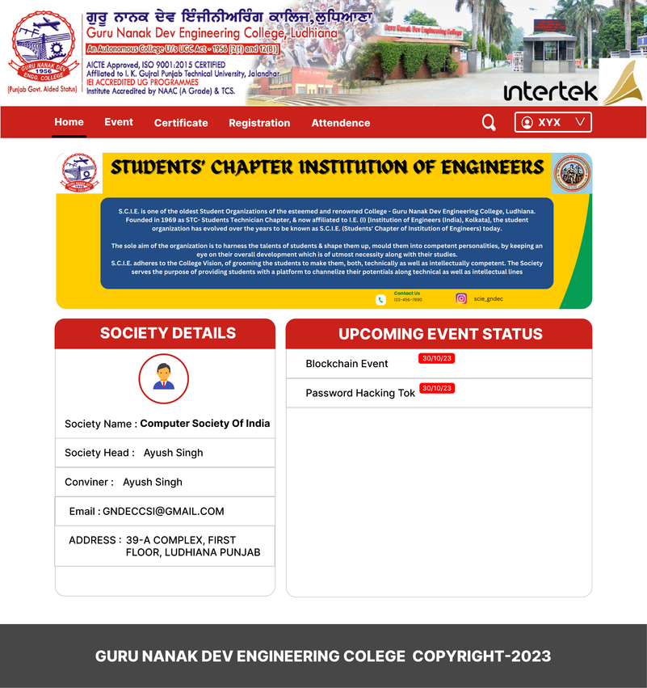


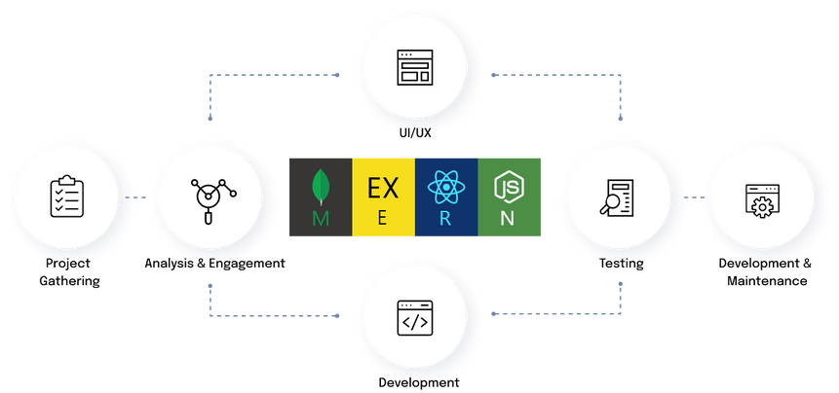




Prototype UI
Problem Approach & Prototype
User registers on portal.
Data collected and will be managed by society
User and organisation can keep track of events.
Notification via e-mail is enabled.
Event created and the link will be generated for the form to fill.
Attendance will be marked during and at the end of event.
After result declaration, certificates will get generated for the participants and winners automatically.
User can download certificate any time.
WORKING
DATA COLLECTING
ATTENDANCE MARKED
CERTIFICATE CAN BE DOWNLOADED
FLOWCHART
STEP 2
STEP 4
STEP 6
STEP 1
STEP 3
STEP 5
USER REGISTRATION
EVENT CREATED BY ORGANIZATION
RESULTS ANNOUNCED
ALL THIS WITH JUST A WEBSITE..!!

Slide 3

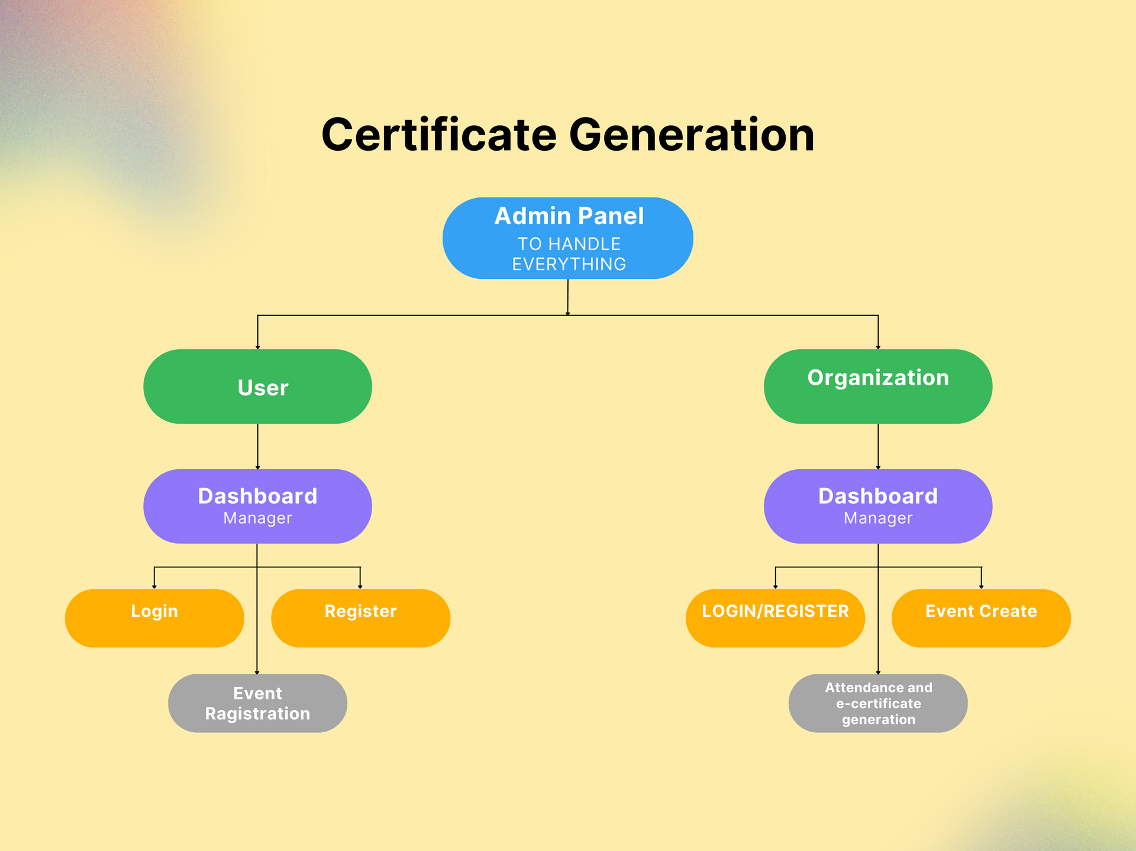

Slide 4














USE CASES
DEPENDENCIES
Our application requires access to the internet.
Efforts will be less and the certificate will be generated automatically for the attendance.
SELLING POINTS
Hassle free registration for the event by the user in just one click as database is saved.
The project is highly cost efficient.
On the day of the event , the users shall be notified via email.
Output generation is easy & fast.
The usage of hardware is minimal.
Time interval for attendance is flexible.
Eliminates the scope of proxy attendance.
Output in pdf form of any candidate can be generated at any instance.
User-friendly interface.

Slide 5



Team Member Details
S.No | Name | Branch | Stream | Year | Position
1 | Prashant Singh Yadav | B.Tech | IT | 3rd | Team Leader (UI & Full Stack Developer)
2 | Rhythm | B.Tech | CSE | 2nd | Content Manager
3 | Manish Kumar | B.Tech | EE | 3rd | Frontend Developer
4 | Ayush Singh | B.Tech | IT | 3rd | Frontend Developer
5 | Ansul Pal | B.Tech | IT | 3rd | Full Stack Developer
6 | Manveer Kaur Dhaliwal | B.Tech | CSE | 2nd | R & D Manager

